Slide 1
Topic 12
Repetition and Loops

Slide 2
Repetition in Programs
Remember that there are 3 types of program control structures: sequence, selection and repetition.
Just as the ability to make decisions is an important programming tool, so is the ability to specify repetition of a group of operations.

Slide 3
Repetition in Programs
Suppose we want a program to add 4 pairs of numbers.
Example:
34526 + 23135 = ?
4222 + 29856 = ?
30765 + 45692 = ?
590299 + 87823 = ?

Slide 4
Repetition in Programs
This flowchart shows how a
program can add 2 numbers.
Start
Read n1, n2
sum ← n1 + n2
Display sum
Stop

Slide 5
Repetition in Programs
Do we extend the flowchart
with the same set of steps
for the 4 pairs of numbers?
Start
Read n1, n2
sum ← n1 + n2
Display sum
Stop

Slide 6
Repetition in Programs
Start
Read n1, n2
Read n1, n2
3rd
pair
sum ← n1 + n2
1st
pair
sum ← n1 + n2
Display sum
Display sum
Read n1, n2
Read n1, n2
sum ← n1 + n2
4th pair
2nd pair
sum ← n1 + n2
Display sum
Display sum
Stop

Slide 7
Loops
What if we have 100 pairs?
We cannot keep extending the program in this way!
We need a control structure that allows us to say that we want to repeat some steps in the program.
This is the repetition control structure.
The repetition of steps in a program is called a loop.

Slide 8
Loops
This flowchart shows the concept of a loop.
The loop action or actions form the loop body.
One loop iteration is one execution of the loop body.

Slide 9
Loops
Example – to add many pairs of numbers:
Read n1, n2
sum ← n1 + n2
Display sum

Slide 10
Loops
But this loop never stops. It is called an infinite loop.
We want our loop to end when the work is done
i.e. we iterate or repeat the loop actions until the work is done.
To make sure it ends, we must have a condition that controls the loop. This condition is called a loop control expression.

Slide 11
Loops
The condition must be tested before or after each iteration to decide whether to repeat the loop one more time or exit/terminate the loop.
There are two types of loops depending on when the condition is tested:
Pretest loop
Post-test loop

Slide 12
Loops
Pretest loop:
In each iteration, the control expression is tested first. If it is true, the loop action(s) are executed; otherwise, the loop terminates.
Post-test loop:
In each iteration, the loop action(s) are executed. Then the control expression is tested. If it is true, a new iteration is started; otherwise, the loop terminates.

Slide 13
Pretest Loop
This flowchart shows a pretest loop.
loop test
loop body – executed while condition is true.

Slide 14
Post-Test Loop
This flowchart shows a post-test loop.
loop body – executed while condition is true .
loop test

Slide 15
Pretest versus Post-Test Loops

Slide 16
The while Statement
C/C++ implements a pretest loop with a while statement.
The while statement is a pretest loop statement that uses an expression as a decision condition to control the loop.
Since it is pretest, it tests the expression before every iteration of the loop.

Slide 17
The while Statement
Note: no semicolon at end
single statement in loop body

Slide 18
The while Statement
compound statement as loop body

Slide 19
Counter-Controlled Loop
If we know the number of times an action is to be repeated, we use a counter-controlled loop or counting loop.
For example, we want to add 4 pairs of numbers. We want to repeat the addition of pairs of numbers 4 times.
In a counter-controlled loop, its repetition is managed by a loop control variable called a counter which represents the loop count.

Slide 20
Counter-Controlled Loop
The loop control variable’s value determines whether the loop is repeated.
Remember to perform the following 3 steps for loop control variables:
Initialization – initialize the loop control variable or set it to the initial value before the first iteration of the loop.
Testing – test its value before the start of each loop iteration.
Updating – update its value at the end of each loop iteration.

Slide 21
Counter-Controlled Loop
Flowchart
initialization
testing
updating

Slide 22
Counter-Controlled Loop
Flowchart
Pseudocode
set count to 0
while count < n
[Action(s)]
increment count

Slide 23
Counter-Controlled Loop
Flowchart
Pseudocode
set count to 0
while count < 4
Read n1, n2
sum ← n1 + n2
Display sum
count = count + 1
count = 0
false
count < 4
true
Read n1, n2
sum ← n1 + n2
Display sum
count = count + 1

Slide 24
Counter-Controlled Loop
C/C++ code using the while statement :
int count = 0; // initialization
while (count < 4) // testing
{
cout << "Enter two numbers: ";
cin >> n1 >> n2;
sum = n1 + n2;
cout << "Sum is " << sum << endl;
count = count + 1; // updating
}

Slide 25
Counter-Controlled Loop
count = 0
count < 4
false
int count = 0;
while (count < 4)
{
cout << "Enter two numbers:";
cin >> n1 >> n2;
sum = n1 + n2;
cout << "Sum is " << sum << endl;
count = count + 1;
}
true
Read n1, n2
sum ← n1 + n2
Display sum
count = count + 1

Slide 26
Increment and Decrement Operators
The statement as follows is commonly used:
count = count + 1;
C/C++ provides an increment operator (++):
count++;
This statement means the same as the above.
The side effect of this statement is that the value of count is incremented by 1.

Slide 27
Increment and Decrement Operators
The ++ is used for count in the loop body:
int count = 0;
while (count < 4)
{
cout << "Enter two numbers: ";
cin >> n1 >> n2;
sum = n1 + n2;
cout << "Sum is " << sum << endl;
count ++; // increment by 1
}

Slide 28
Increment and Decrement Operators
Similarly C/C++ provides a decrement operator (--).
count--;
This statement has the same meaning as the following:
count = count - 1;

Slide 29
Compound Assignment Operators
The statement form as follows is also commonly used:
variable = variable op expression;
where op is an arithmetic operator.
Example:
number = number + 2;
C/C++ provides the compound assignment operator of the form op=:
+=, -=, *=, /=, %=

Slide 30
Compound Assignment Operators
The statement as follows:
number += 2;
is an alternative way of writing: number = number + 2;
Similarly the statement as follows:
product *= number;
is an alternative way of writing: product = product * number;

Slide 31
The for Statement
C/C++ also provides the for statement to implement a pretest loop.
The for statement is a pretest loop statement that uses 3 expressions:
First expression – initialization statement – executed when the for starts.
Second expression – limit-test expression – tested before every iteration.
Third expression – updating expression – executed at the end of each iteration.

Slide 32
The for Statement
Note: no semicolon at end

Slide 33
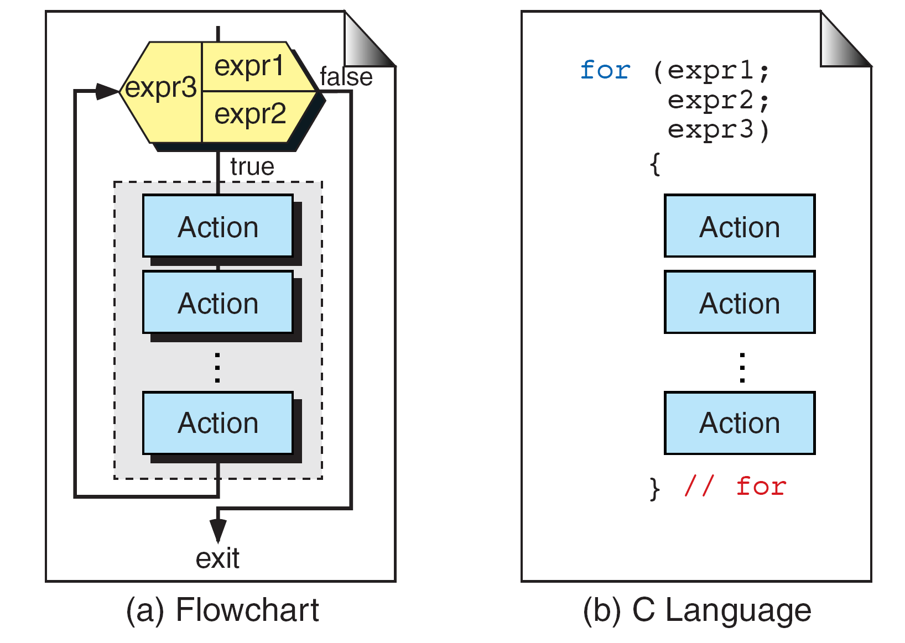
The for Statement
compound statement as loop body

Slide 34
The for Statement
Example:
for ( int count = 0;
count < 4;
count++ )
{
cout << "Enter two numbers: ";
cin >> n1 >> n2;
sum = n1 + n2;
cout << "Sum is " << sum << endl;
}

Slide 35
The for Statement
Example – alternative style:
for ( int count = 0; count < 4; count++ )
{
cout << "Enter two numbers: ";
cin >> n1 >> n2;
sum = n1 + n2;
cout << "Sum is " << sum << endl;
}

Slide 36
The for Statement
count = 0
count < 4
false
for ( int count = 0;
count < 4;
count++ )
{
cout << "Enter two numbers:";
cin >> n1 >> n2;
sum = n1 + n2;
cout << "Sum is " << sum << endl;
}
true
Read n1, n2
sum = n1 + n2
Display sum
count = count + 1

Slide 37
Generating Sequence of Numbers
Example – numbers increasing from 1 to 5:
for ( int count = 1; count <= 5; count++ )
cout << count;
count | count <= 5 | output
1 | true | 12
2 | true
count | count <= 5 | output
1 | true | 1
count | count <= 5 | output
1 | true | 123
2 | true
3 | true
count | count <= 5 | output
1 | true | 1234
2 | true
3 | true
4 | true
count | count <= 5 | output
1 | true | 12345
2 | true
3 | true
4 | true
5 | true
count | count <= 5 | output
1 | true | 12345
2 | true
3 | true
4 | true
5 | true
6 | false

Slide 38
Generating Sequence of Numbers
Example – numbers decreasing from 5 to 1:
for ( int count = 5; count >= 1; count-- )
cout << count;
count | count >= 1 | output
5 | true | 54321
4 | true
3 | true
2 | true
1 | true
count | count >= 1 | output
5 | true | 54321
4 | true
3 | true
2 | true
1 | true
0 | false
count | count >= 1 | output
5 | true | 54
4 | true
count | count >= 1 | output
5 | true | 5
count | count >= 1 | output
5 | true | 543
4 | true
3 | true
count | count >= 1 | output
5 | true | 543
4 | true
3 | true
2 | true

Slide 39
Generating Sequence of Numbers
Example – even numbers from 2 to 10:
for ( int num = 2; num <= 10; num += 2 )
cout << num << " ";
num | num <= 10 | output
2 | true | 2 4 6 8 10
4 | true
6 | true
8 | true
10 | true
12 | false

Slide 40
Generating Sequence of Numbers
Example – multiples of 3 decreasing from 15 to 3:
for ( int num = 15; num > 1; num -= 3 )
cout << num << " ";
num | num > 1 | output
15 | true | 15 12 9 6 3
12 | true
9 | true
6 | true
3 | true
0 | false

Slide 41
Generating Sequence of Numbers
Example –numbers increasing from 1 to an upper limit:
cout << "Enter limit: ";
cin >> limit;
for ( int num = 1; num <= limit; num++ )
cout << num << " ";
Output
Enter limit: 10
1 2 3 4 5 6 7 8 9 10

Slide 42
Generating Sequence of Numbers
Example – numbers decreasing from an upper limit down to 1:
cout << "Enter limit: ";
cin >> limit;
for ( int num = limit; num >= 1; number-- )
cout << num << " ";
Output:
Enter limit: 10
10 9 8 7 6 5 4 3 2 1

Slide 43
for Statement versus while Statement
A for statement is used when a loop is to be executed a known number of times.
We can do the same thing with a while statement, but the for statement is easier to read and more natural for counting loops.
Both the for and while statements are used to implement pretest loops.

Slide 44
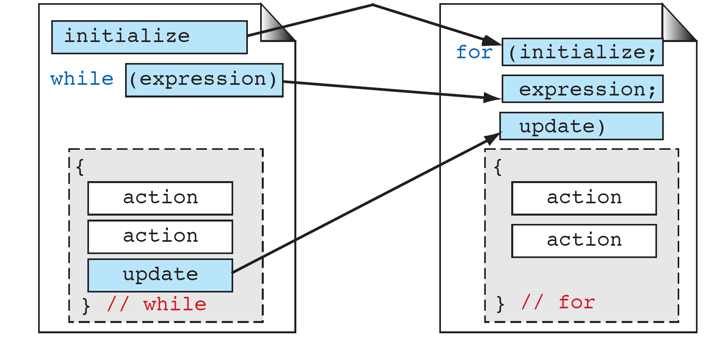
for Statement versus while Statement
Comparing while statement and for statement:

Slide 45
Program Design
When developing the solution to a problem, ask yourself the following question to determine whether a loop is required in the algorithm:
Do I need to repeat any steps?
If your answer is yes, then ask yourself the following question:
Which steps do I need to repeat?
Next ask yourself :
Do I know how many times I need to repeat?
If the answer is yes, a counter-controlled loop can be used.

Slide 46
Case Study 1
Problem:
A company has several employees whose pay must be calculated.
Develop the solution:
Do I need to repeat any steps?
Yes.

Slide 47
Case Study 1
Which steps do I need to repeat?
The computation and display of the pay for each
employee.
Do I know how many times I need to repeat?
Yes, for all employees of the company.
The program will first ask the user to enter the
number of employees’ pay to calculate.
Read hours, rate
pay ← hours x rate
Display pay

Slide 48
Case Study 1
Read num_emp
Design the solution
count = 0
false
count < num_emp
true
Read hours, rate
Action for each employee
pay ← hours x rate
Display pay
count = count + 1

Slide 49
Case Study 1
Read num_emp
Design the solution
count = 0
false
count < num_emp
true
Read hours, rate
pay ← hours x rate
Display pay
count = count + 1

Slide 50
Case Study 2
Problem:
Display a conversion table for Celsius and Fahrenheit values, starting with 10 Celsius to -10 Celsius in decreasing steps of 5 Celsius.
Understand the problem:
The output should be as follows, where xxx is the equivalent Fahrenheit value:
Celsius Fahrenheit
10 xxx
5 xxx
0 xxx
-5 xxx
-10 xxx

Slide 51
Case Study 2
Develop the solution
Do I need to repeat any steps?
Yes.
Which steps do I need to repeat?
The computation and display of Fahrenheit.
Do I know how many times I need to repeat?
Yes, for Celsius values starting with 10 to -10 in decreasing steps of 5.
Compute fahrenheit
Display celsius,
fahrenheit

Slide 52
Case Study 2
Design the solution
celsius = 10
false
celsius >= -10
true
Compute fahrenheit
Action for each celsius value
Display celsius,
fahrenheit
celsius = celsius - 5

Slide 53
Case Study 2
Design the solution
celsius = 10
false
celsius >= -10
true
Compute fahrenheit
Display celsius,
fahrenheit
celsius = celsius - 5

Slide 54
Case Study 2
Design the solution
We need to
display a
table heading.
celsius = 10
false
celsius >= -10
true
Compute fahrenheit
Display celsius,
fahrenheit
celsius = celsius - 5

Slide 55
Case Study 2
Design the solution
We need to
display a
table heading.
This is done
only once
before the loop.
celsius = 10
false
celsius >= -10
true
Compute fahrenheit
Display celsius,
fahrenheit
celsius = celsius - 5

Slide 56
Case Study 2
Display heading
Design the solution
celsius = 10
false
celsius >= -10
true
Compute fahrenheit
Display celsius,
fahrenheit
celsius = celsius - 5

Slide 57
Case Study 2 – Program Development 1
#include <iostream>
using namespace std;
int main(void)
{
int cels; // Celsius value
double fahr; // Fahrenheit value
// display 1 celsius-fahrenheit value
cels = 10;
fahr = 1.8 * cels + 32.0;
cout << cels << "\t" << fahr << endl;
return 0;
}

Slide 58
Case Study 2 – Program Development 2
#include <iostream>
using namespace std;
int main(void)
{
int cels; // Celsius value
double fahr; // Fahrenheit value
// display table of celsius-fahrenheit values
for (cels = 10; cels >= -10; cels -= 5)
{
fahr = 1.8 * cels + 32.0;
cout << cels << "\t" << fahr << endl;
}
return 0;
}

Slide 59
Case Study 2 – Complete Program
#include <iostream>
using namespace std;
int main(void)
{
int cels; // Celsius value
double fahr; // Fahrenheit value
// display table heading at beginning
cout << "Celsius\tFahrenheit\n";
// to display a table of fahrenheit values
for (cels = 10; cels >= -10; cels -= 5)
{
fahr = 1.8 * cels + 32.0;
cout << cels << "\t" << fahr << endl;
}
return 0;
}

Slide 60
Common Mistakes
If the loop control variable is not updated, its value remains the same and the loop will execute “forever” i.e. it becomes an infinite loop.
Example:
int x = 0;
while (x < 7)
cout << x;
The value of x never increases so the test condition is always true. The loop becomes infinite.

Slide 61
Common Mistakes
If you write a semicolon at the end of the while statement, the C/C++ compiler interprets it as a null statement.
Example:
int x = 0;
while (x < 7) ;
x++;
The C/C++ compiler understands it as:
int x = 0;
while (x < 7)
;
x++;
The value of x never increases, leading to an infinite loop.

Slide 62
Common Mistakes
Similarly if you write a semicolon at the end of the for statement, the C/C++ compiler interprets it as a null statement.
Example:
for ( int j = 0; j < 5; j++ ) ;
cout << "j is " << j << endl;
The C/C++ compiler understands it as:
for ( int j = 0; j < 5; j++ )
;
cout << "j is " << j << endl;
The for statement does nothing 5 times.

Slide 63
Comma Operator
Suppose we want to initialize a variable before a loop starts.
Example:
int j = 5;
for (int i = 0; i < n; i++)
{
cout << i << " " << j << endl;
j--;
}
We can perform the initialization and/or updating in the for statement with the use of a comma operator:
for (int i = 0, j = 5; i < n; i++, j--)
cout << i << " " << j << endl;

